Slide 1
IEEE 39 Bus with Solar PV

Slide 2
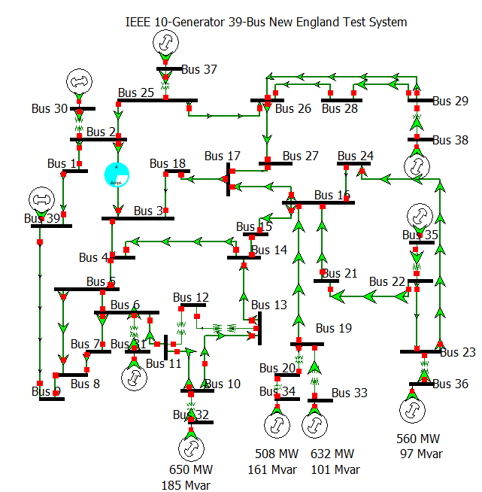

Slide 3
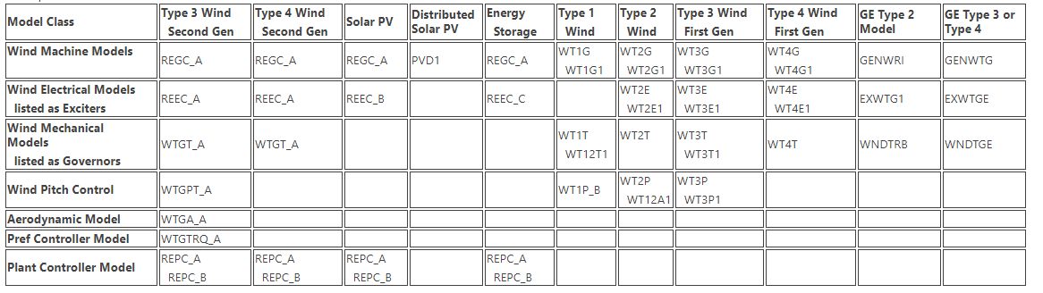
Power World: Renewable Energy Generation Modeling [1]
Same models recommended by WECC [2]
[1] | https://www.powerworld.com/WebHelp/Content/MainDocumentation_HTML/Transient_Stability_Overview_WindModeling.htm
[2] | https://www.wecc.org/Reliability/WECC%20Solar%20Plant%20Dynamic%20Modeling%20Guidelines.pdf

Slide 4
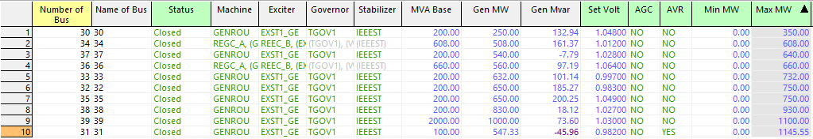
Selecting Solar PV Generators
Select the 2 smallest generators with lowest Max MW and replace with Solar PV
Gen 30 and 37 are of interest for forced oscillation studies
Choose Gen 34 and 36 to be Solar PV generators
Gen Ordered by Lowest to Highest Max MW

Slide 5
Power World: SMIB Analysis
 | Power World SMIB |  | FO Freq Scan
Generator | Damping | Freq Hz
30 | 0.102 | 1.1629 | ~1.15 - 1.25 Hz
31 | 0.1683 | 1.2595
32 | 0.1857 | 1.3743
33 | 0.1556 | 1.5797
34 | 0.8903 | 3.3909
35 | 0.2208 | 1.2609
36 | 0.9173 | 2.9991
37 | 0.1899 | 1.7439 | ~1.75 Hz
38 | 0.2622 | 1.259
39 | 0.1607 | 0.4044 | ~0.65 Hz
Table contains the frequency with the smallest damping ratio for each generator
Full Power World eigenvalue results are in Appendix A
Previous results with no renewable generation are in Appendix B

Slide 6
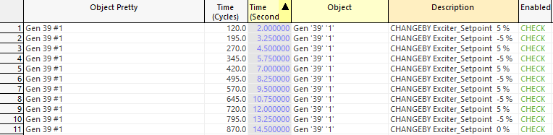
Gen 39 Exciter Setpoint Frequency Sweep
Perturb exciter setpoint by +/- 5% rectangular pulse of starting setpoint
Perturbation frequencies:
0.4 Hz
0.5 Hz
0.6 Hz
0.7 Hz
0.8 Hz
Contingency: Gen 39 Efd Frequency Sweep

Slide 7
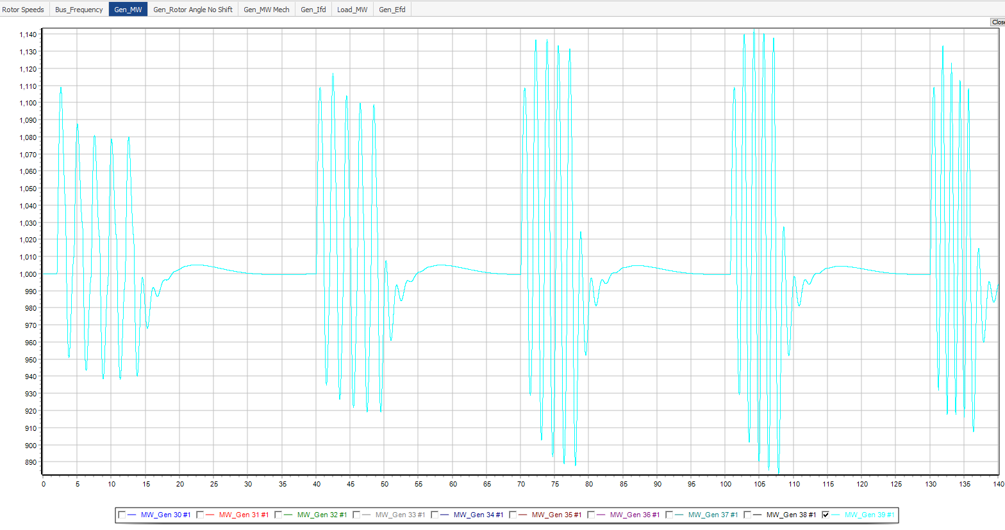
Gen 39 Exciter Setpoint Frequency Sweep
Gen_MW
0.6 Hz
0.7 Hz
0.4 Hz
0.5 Hz
0.8 Hz

Slide 8
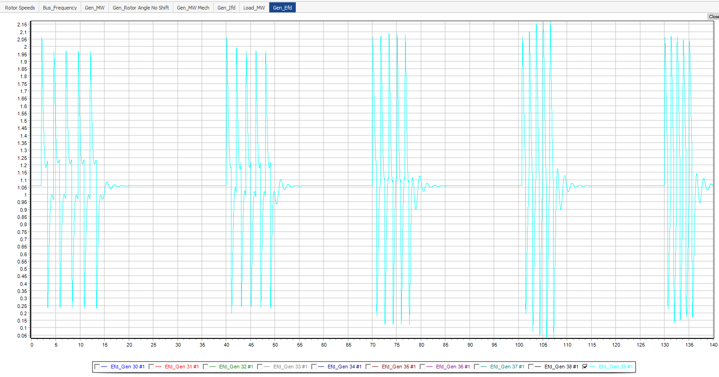
Gen 39 Exciter Setpoint Frequency Sweep
Gen_Efd
0.6 Hz
0.7 Hz
0.4 Hz
0.5 Hz
0.8 Hz

Slide 9
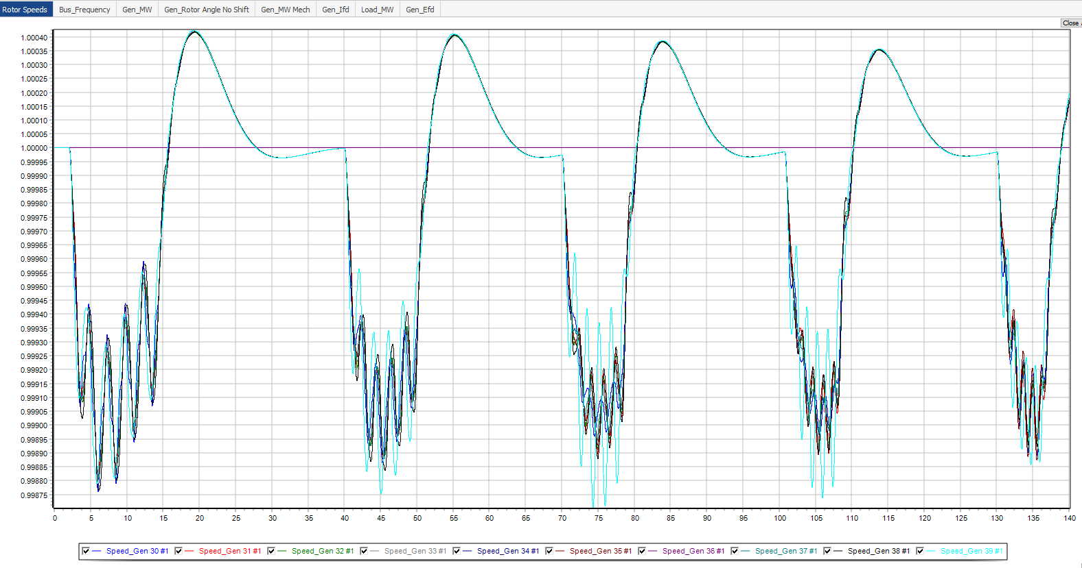
Gen 39 Exciter Frequency Sweep Full Result

Slide 10
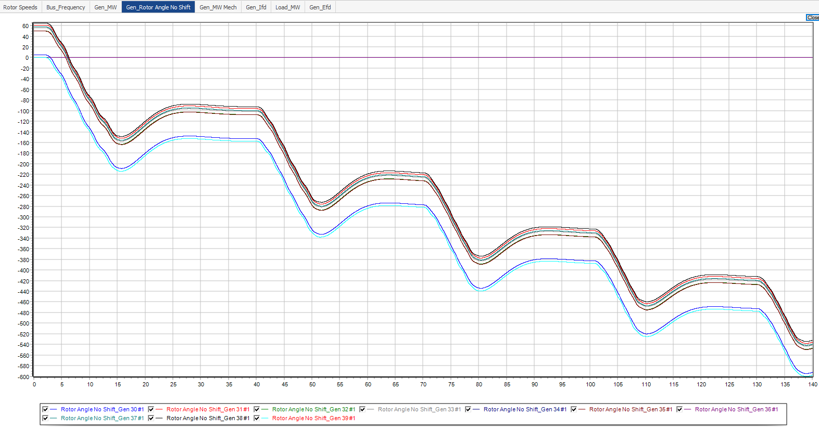
Gen 39 Exciter Frequency Sweep Full Result

Slide 11
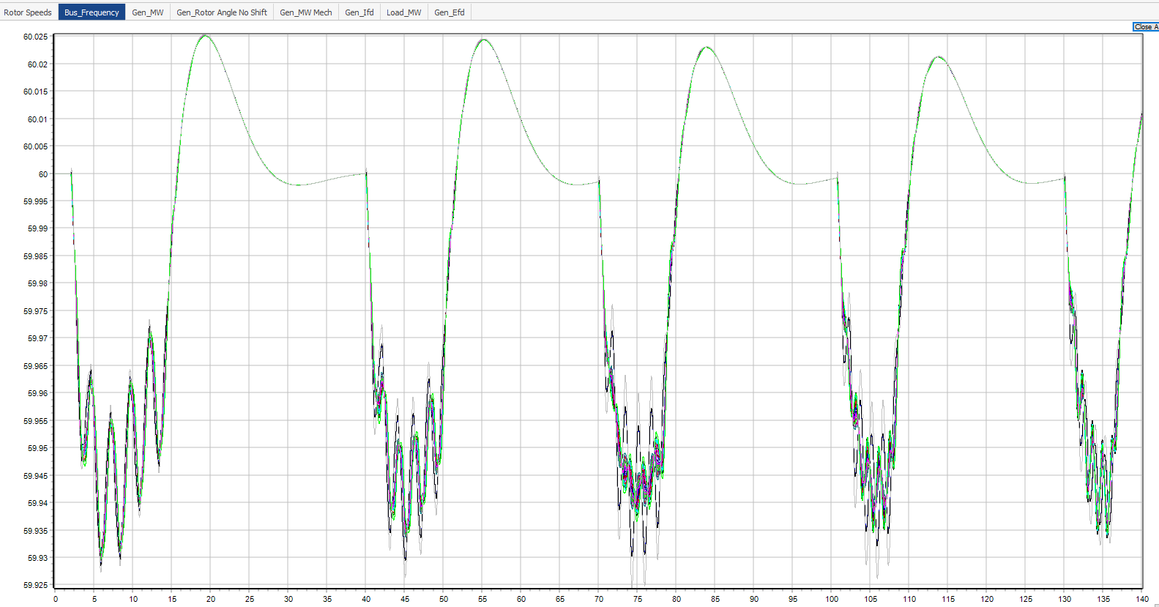
Gen 39 Exciter Frequency Sweep Full Result

Slide 12
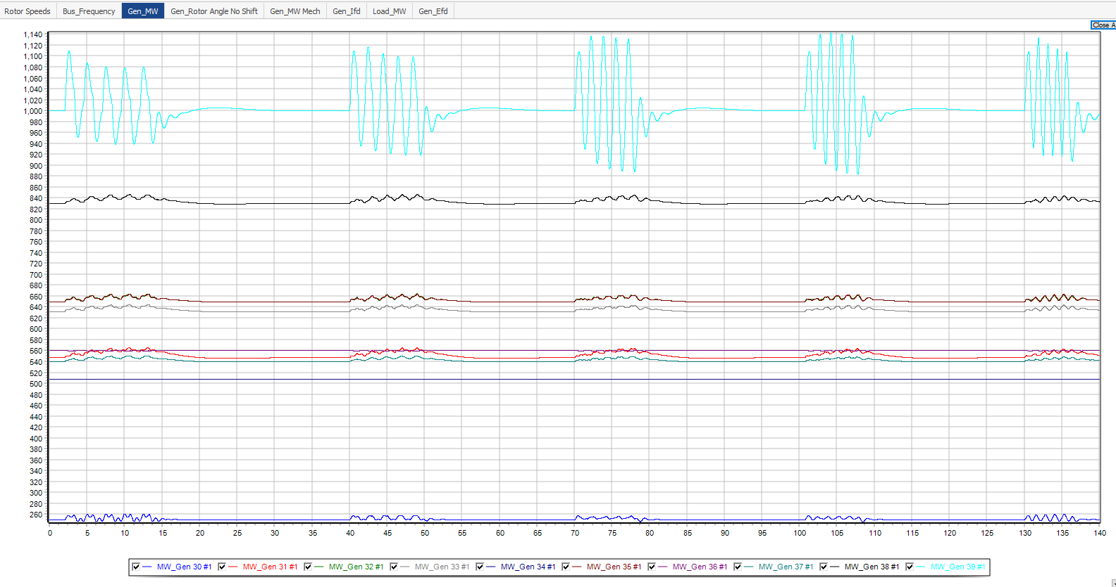
Gen 39 Exciter Frequency Sweep Full Result

Slide 13
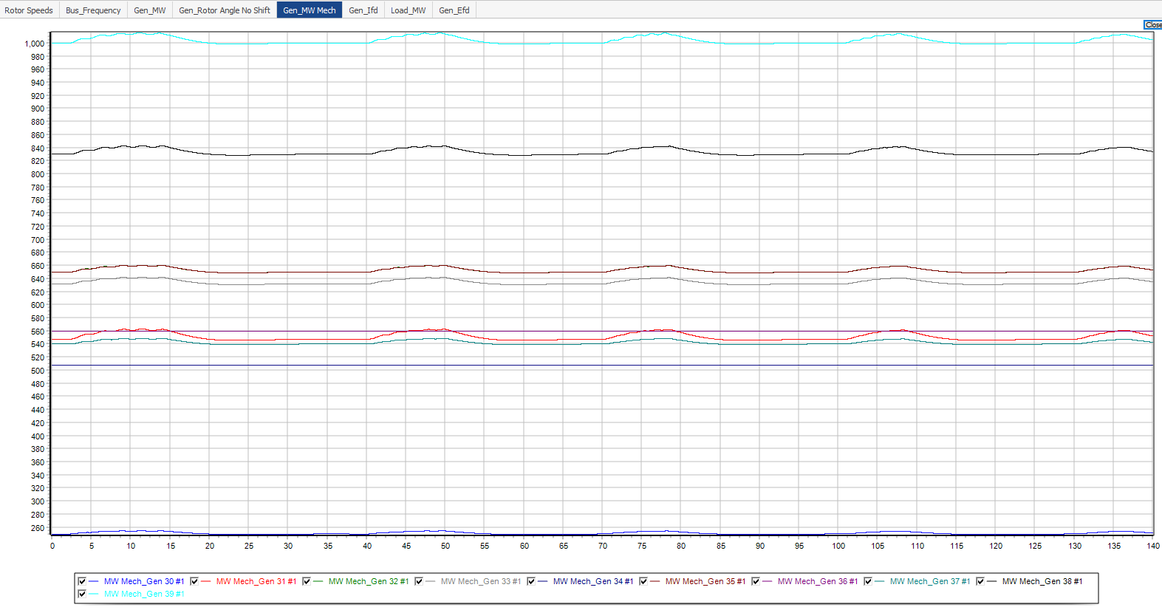
Gen 39 Exciter Frequency Sweep Full Result

Slide 14
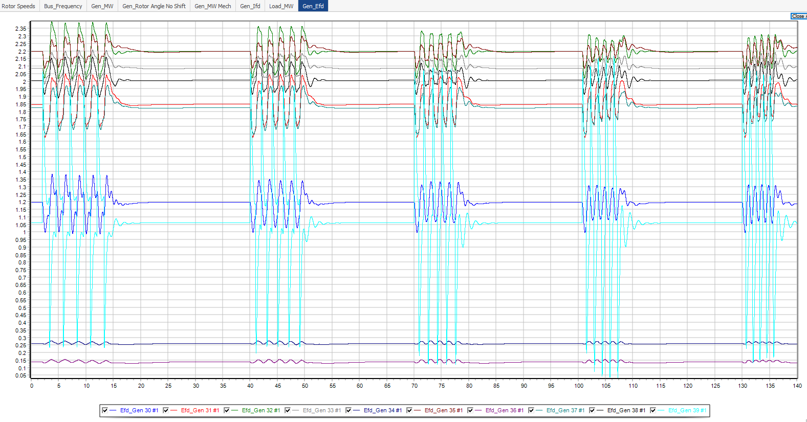
Gen 39 Exciter Frequency Sweep Full Result

Slide 15
Gen 39 Exciter Perturbation Frequency Verification
Scan resulted in a resonance frequency around ~0.7 Hz
Perturb system with frequency 0.7 +/- 0.05 Hz
Perturbation frequencies:
0.65 Hz
0.70 Hz
0.75 Hz
Contingency: Gen 39 Efd Frequency Verification

Slide 16
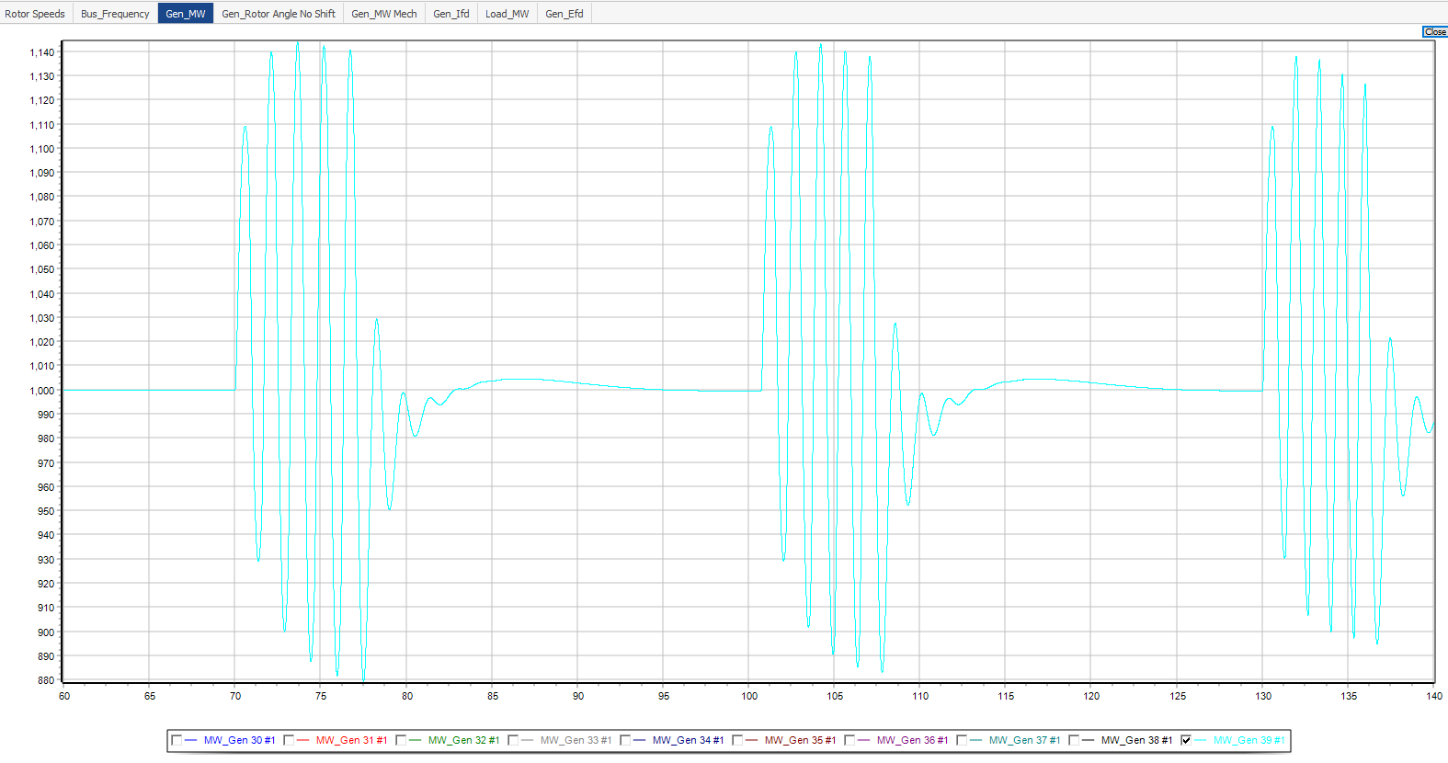
Gen 39 Exciter Perturbation Frequency Verification
Gen_MW
0.65 Hz
0.7 Hz
0.75 Hz

Slide 17
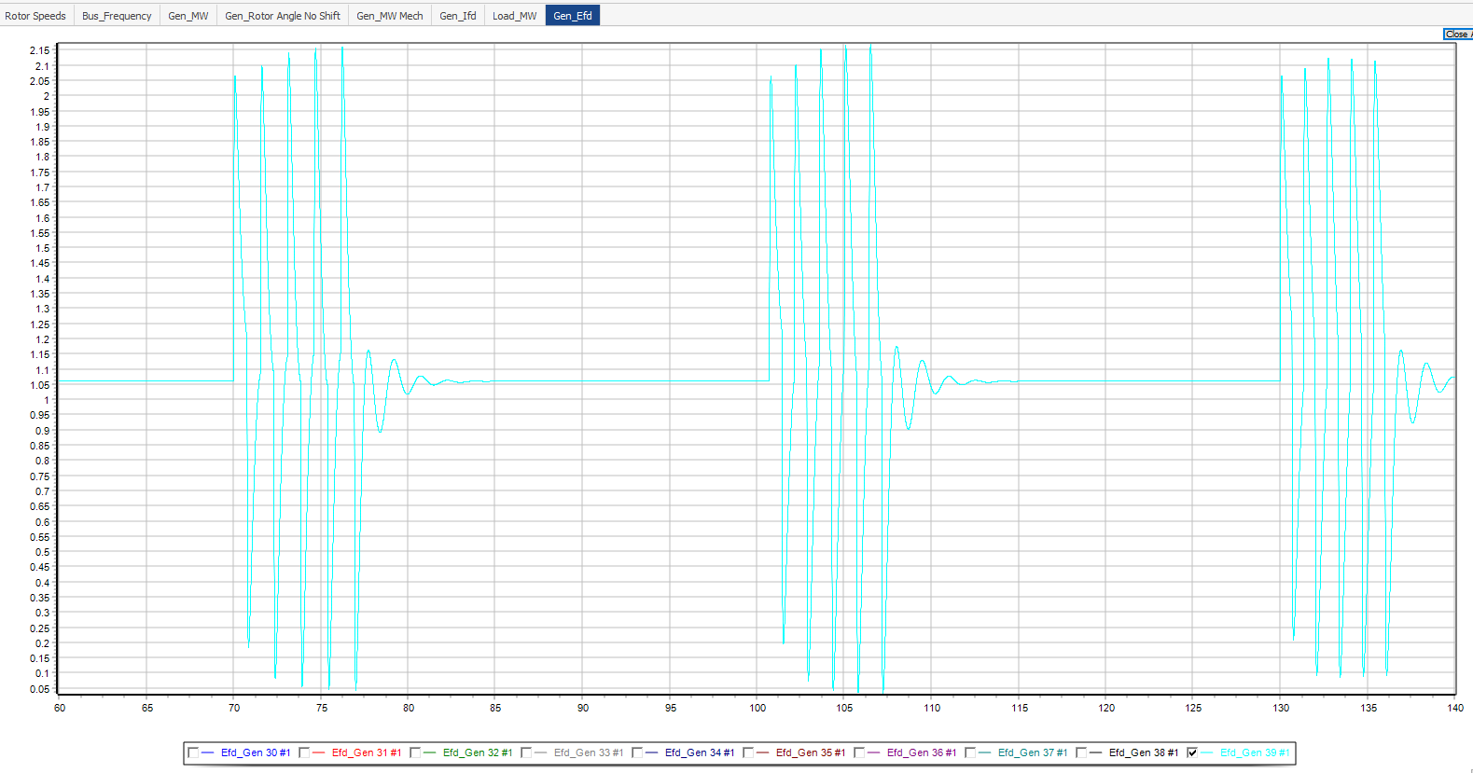
Gen 39 Exciter Perturbation Frequency Verification
Gen_Efd
0.65 Hz
0.7 Hz
0.75 Hz

Slide 18
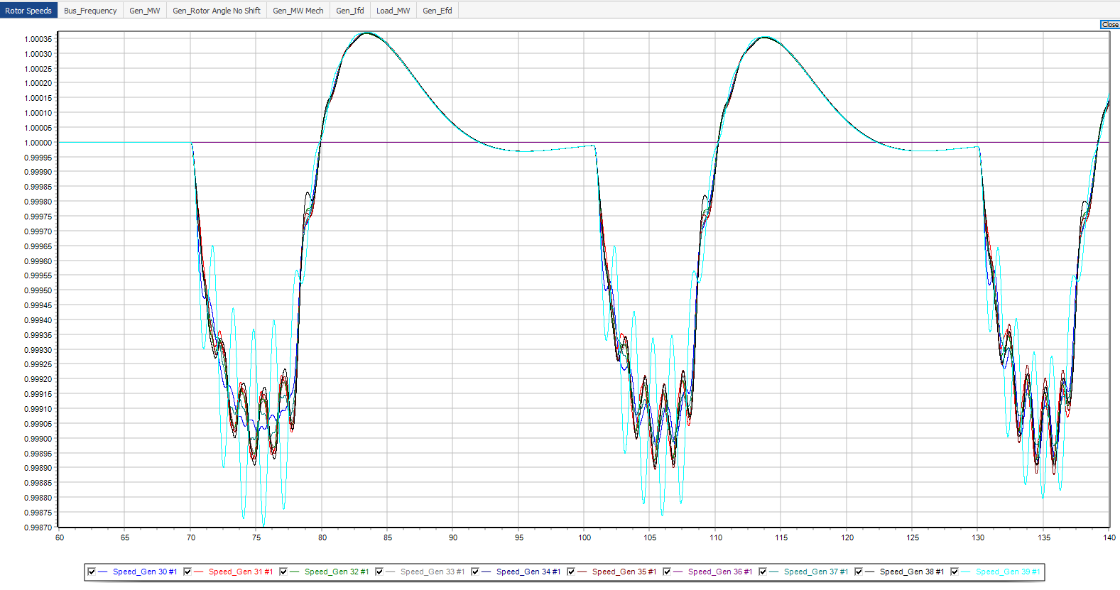
Gen 39 Exciter Frequency Verification Full Results
Solar Gen

Slide 19
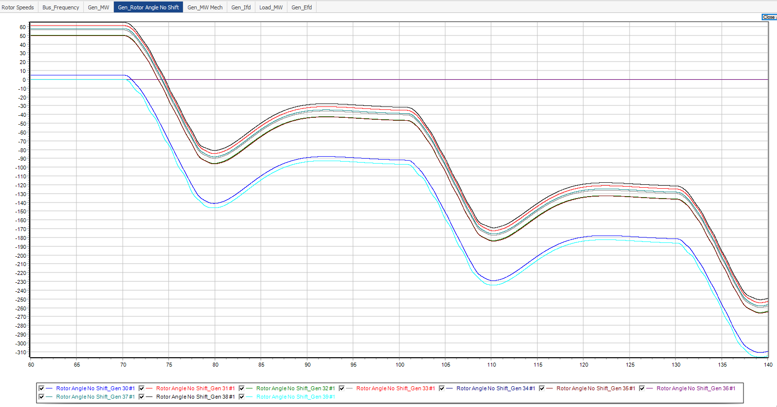
Gen 39 Exciter Frequency Verification Full Results

Slide 20
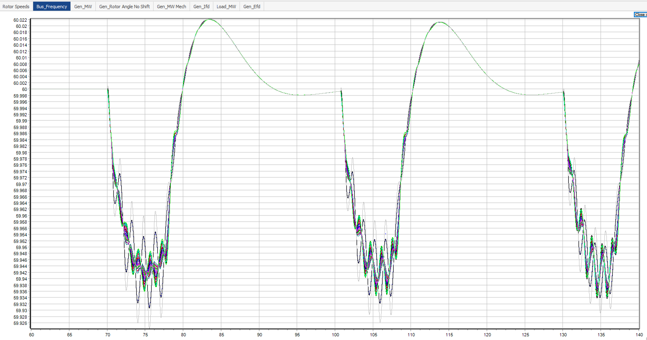
Gen 39 Exciter Frequency Verification Full Results

Slide 21
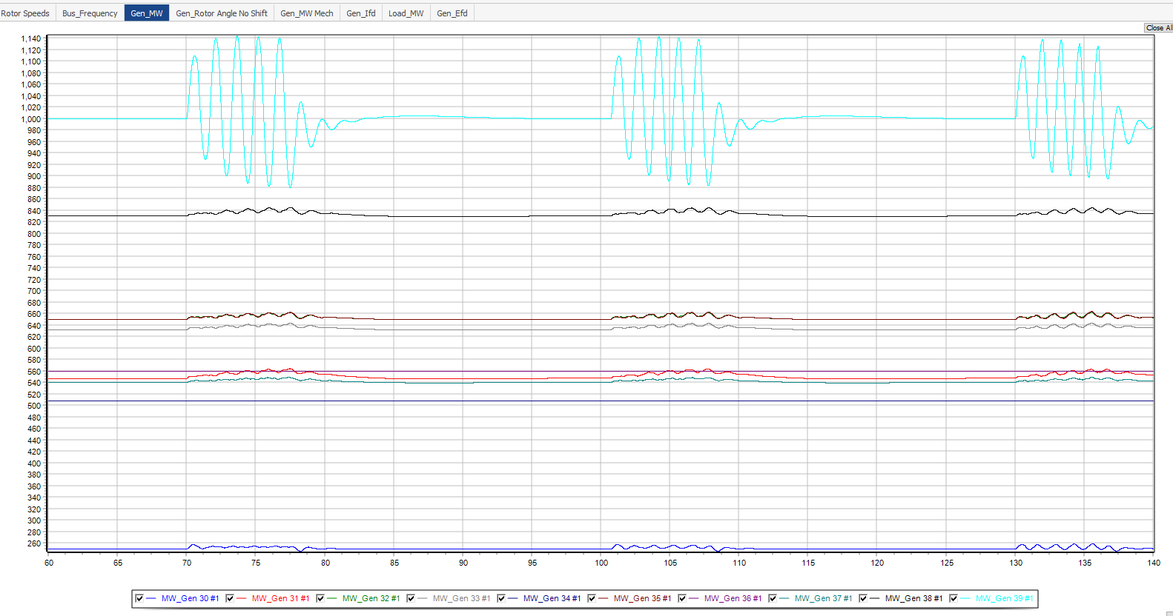
Gen 39 Exciter Frequency Verification Full Results

Slide 22
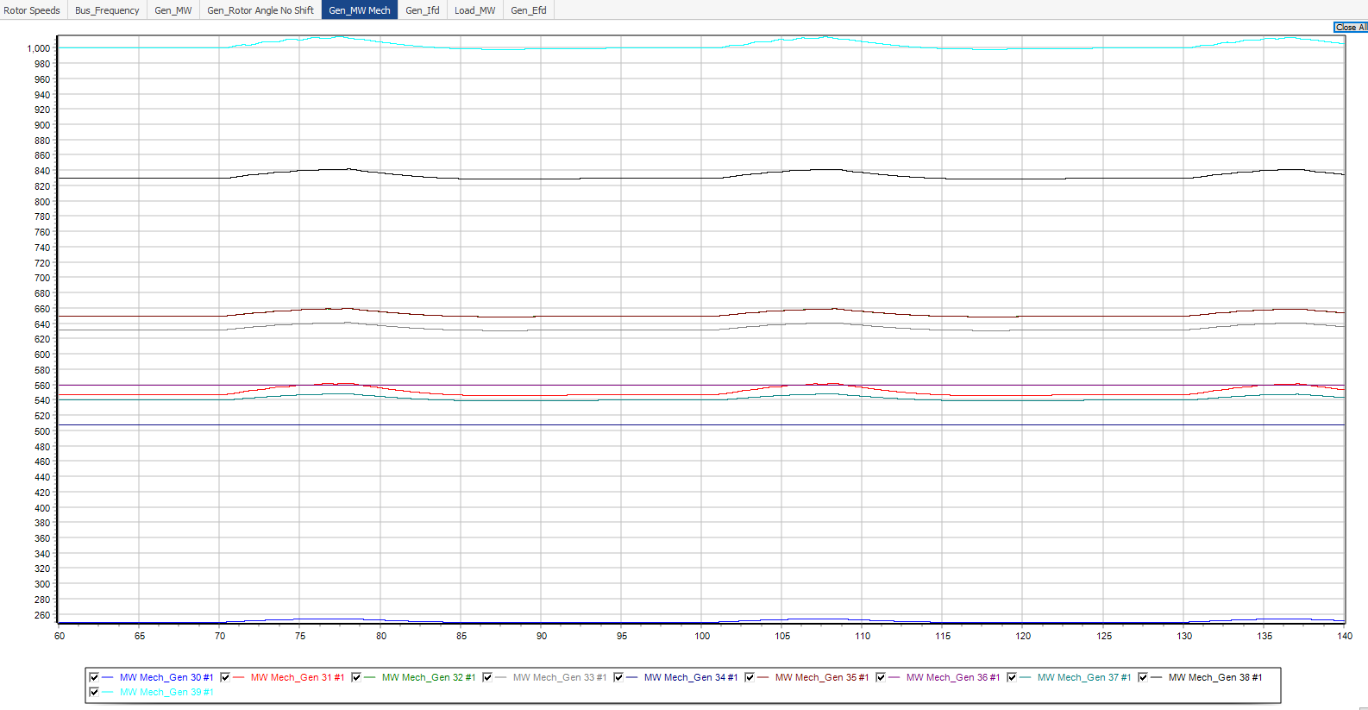
Gen 39 Exciter Frequency Verification Full Results

Slide 23
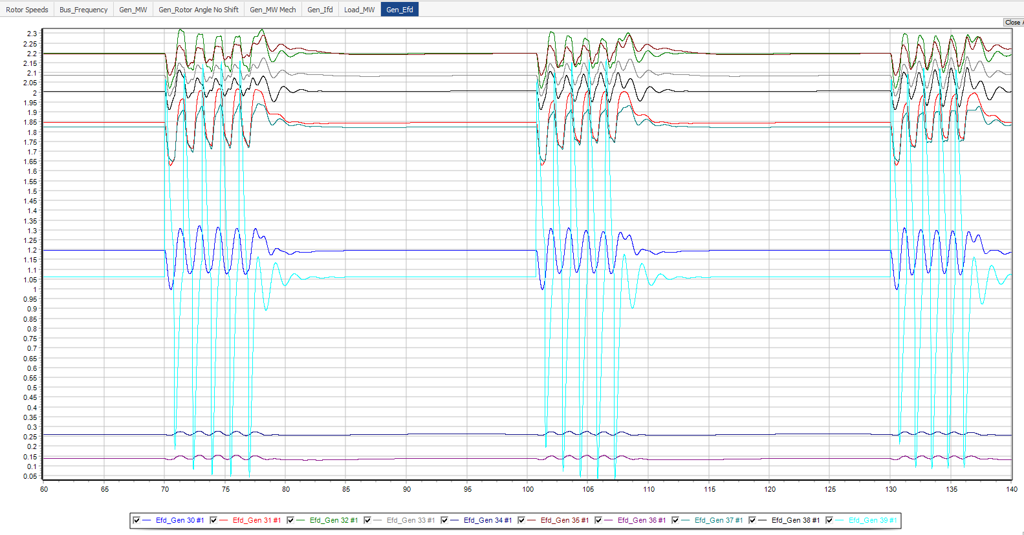
Gen 39 Exciter Frequency Verification Full Results

Slide 24
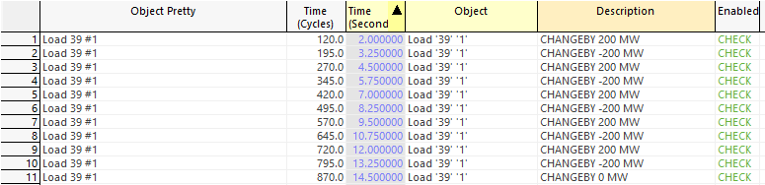
Gen 39 Load Perturbation Frequency Sweep
Perturb load at bus 39 by +/- 200 MW rectangular pulse
Perturbation frequencies:
0.4 Hz
0.5 Hz
0.6 Hz
0.7 Hz
0.8 Hz
Contingency: Gen 39 Load Frequency Sweep

Slide 25
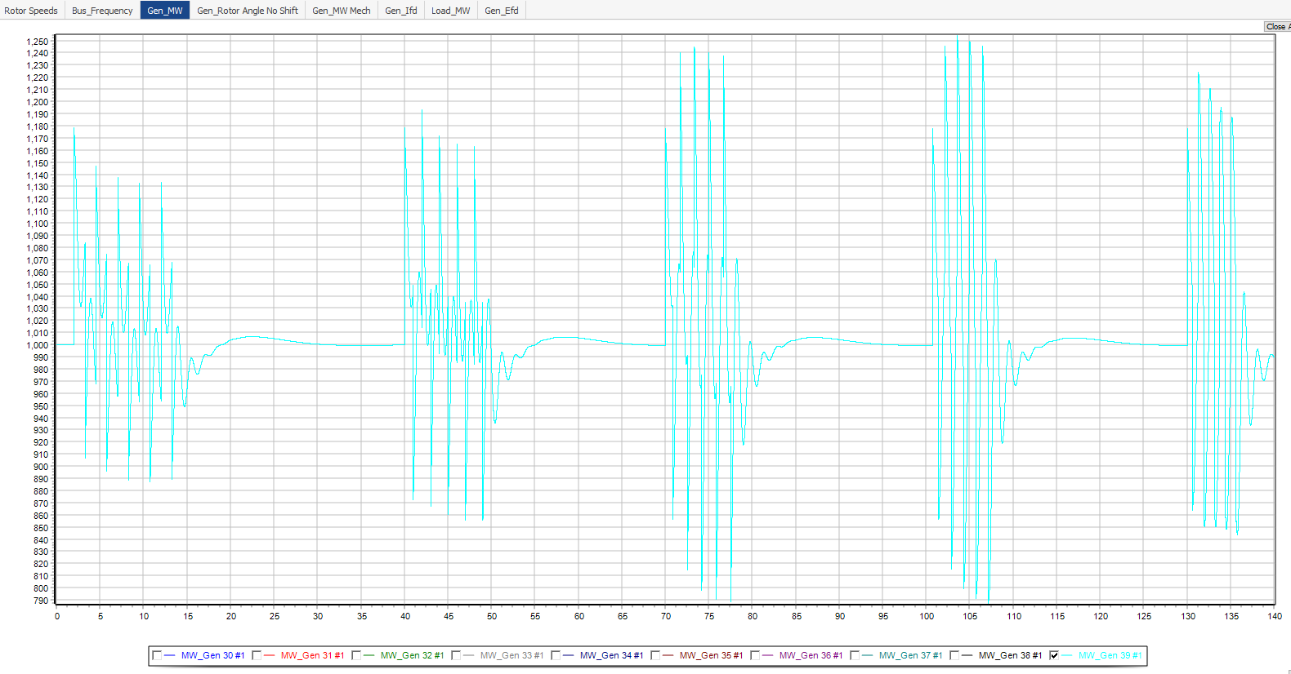
Gen 39 Load Perturbation Frequency Sweep
Gen_MW
0.6 Hz
0.7 Hz
0.4 Hz
0.5 Hz
0.8 Hz

Slide 26
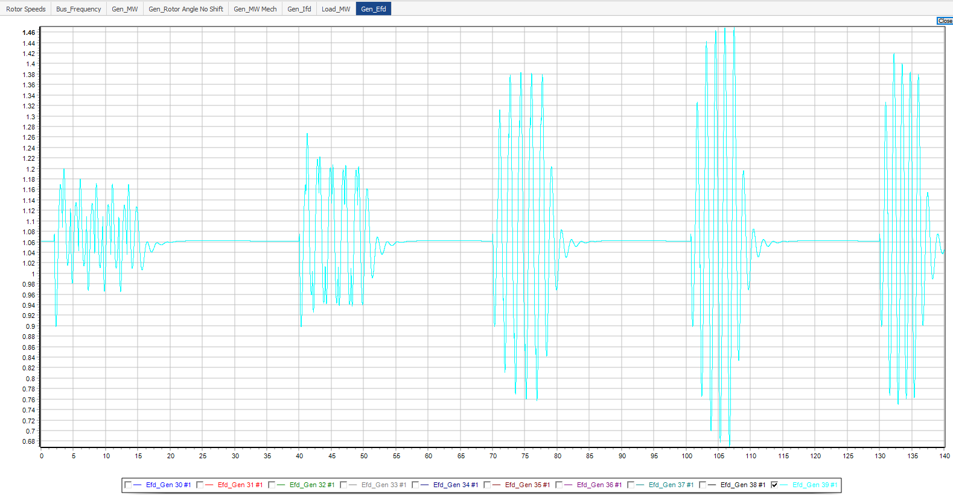
Gen 39 Load Perturbation Frequency Sweep
Gen_Efd
0.6 Hz
0.7 Hz
0.4 Hz
0.5 Hz
0.8 Hz

Slide 27
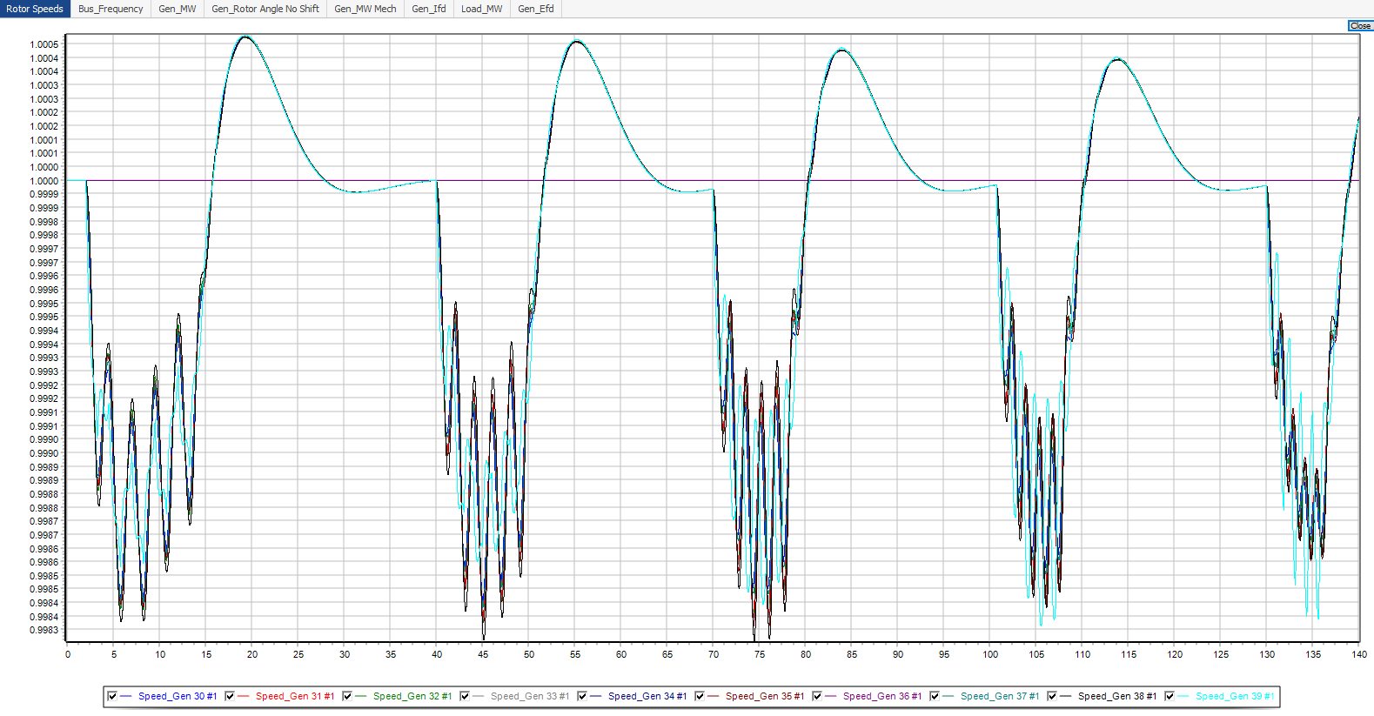
Gen 39 Load Frequency Sweep Full Result

Slide 28
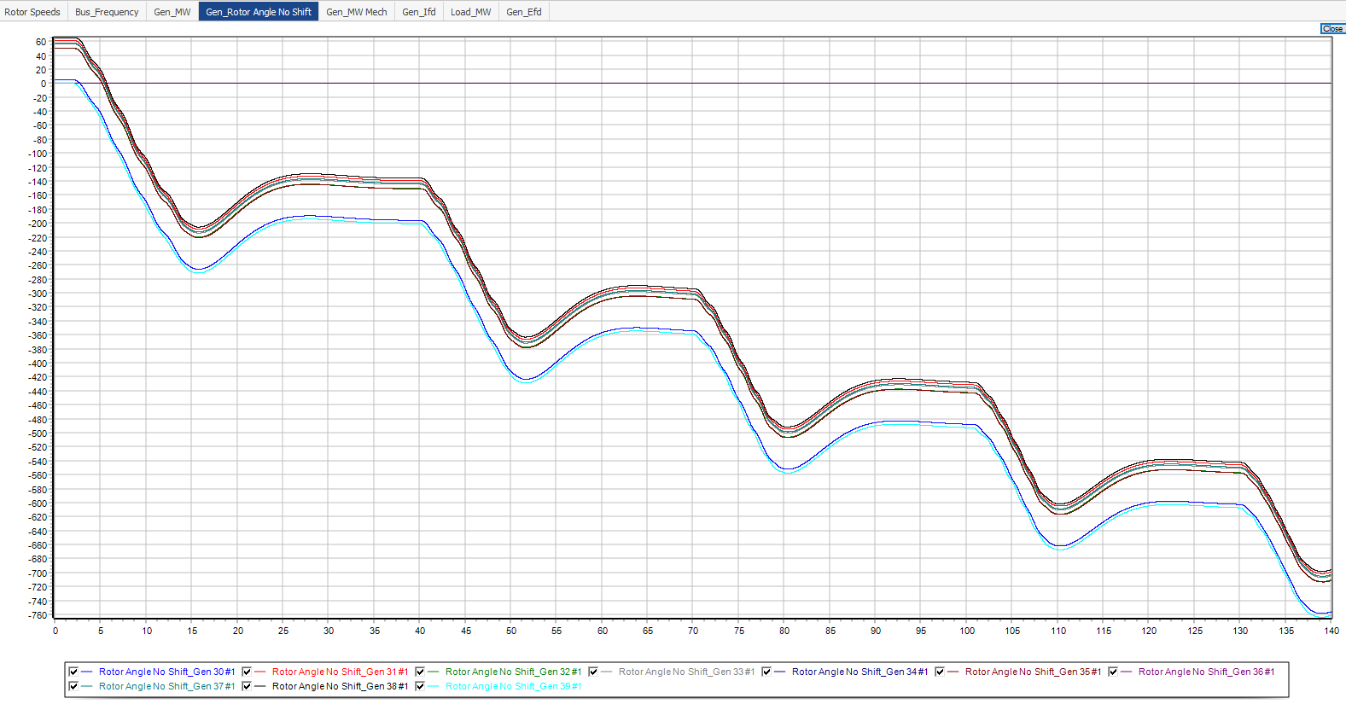
Gen 39 Load Frequency Sweep Full Result

Slide 29
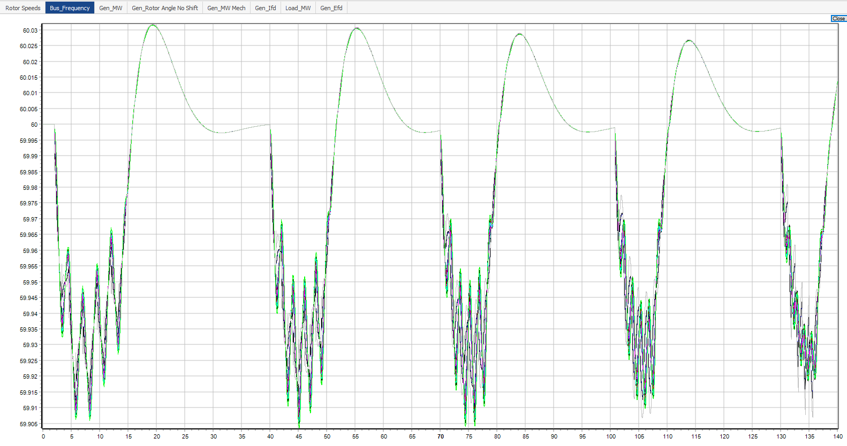
Gen 39 Load Frequency Sweep Full Result

Slide 30
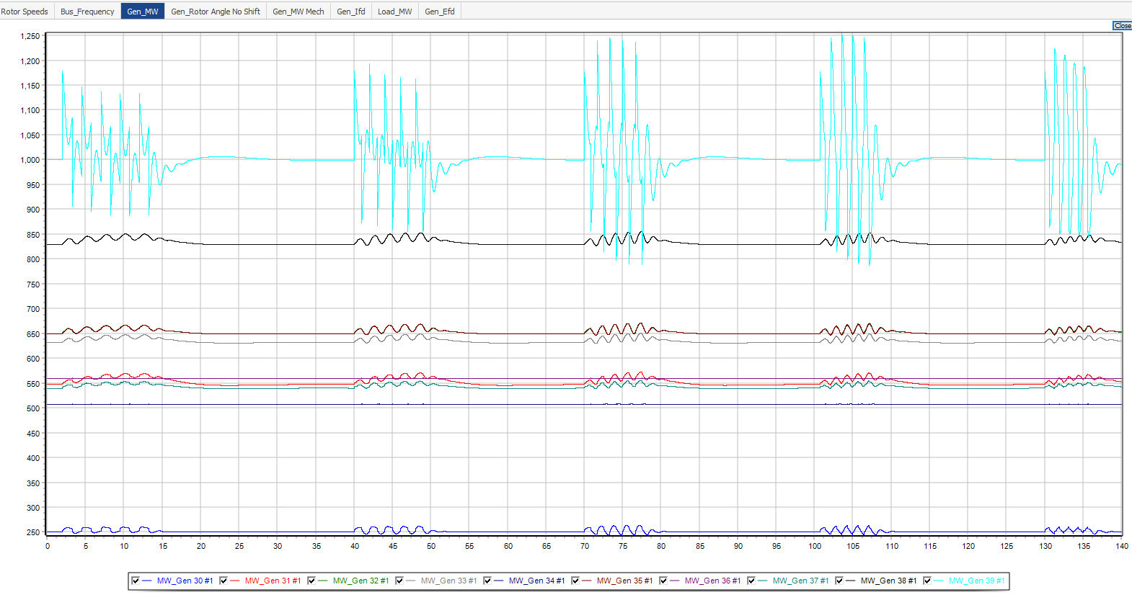
Gen 39 Load Frequency Sweep Full Result

Slide 31

Gen 39 Load Frequency Sweep Full Result

Slide 32
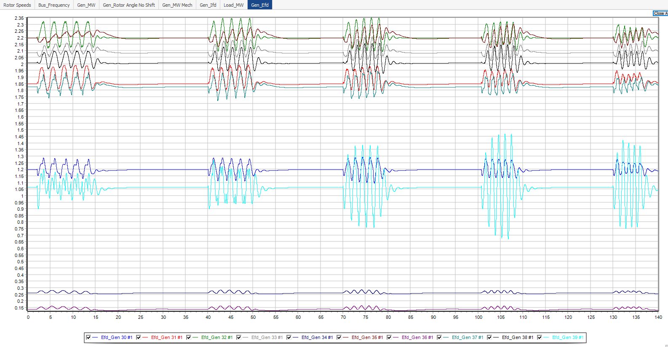
Gen 39 Load Frequency Sweep Full Result

Slide 33
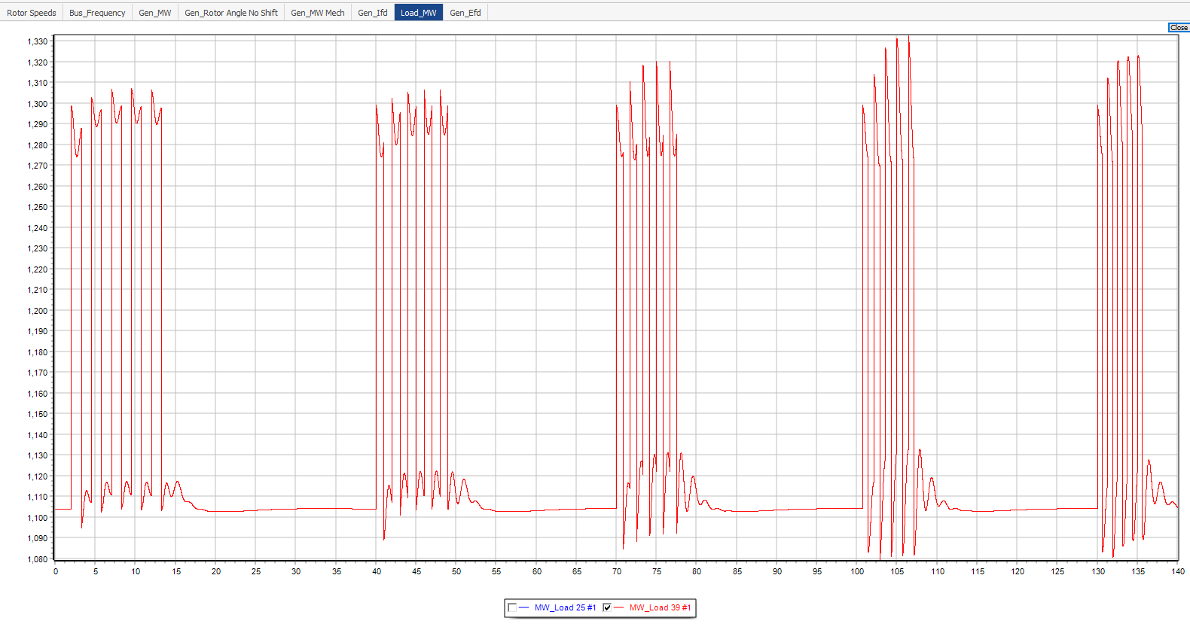
Gen 39 Load Frequency Sweep Full Result

Slide 34
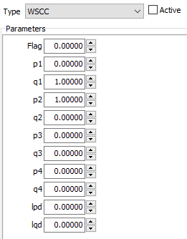
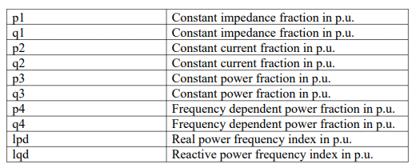
Non-rectangular Load Pulse Shapes
Most likely due to how Power World does it transient/dynamic computation
Changing the parameters and active/inactive of Power Worlds WSCC transient stability load model does change the output load. However, varying the parameters still does not produce a rectangular pulse.
Default parameters and originally set as inactive

Slide 35
Gen 39 Load Perturbation Frequency Verification
Scan resulted in a resonance frequency around ~0.7 Hz
Perturb system with frequency 0.7 +/- 0.05 Hz
Perturbation frequencies:
0.65 Hz
0.70 Hz
0.75 Hz

Slide 36
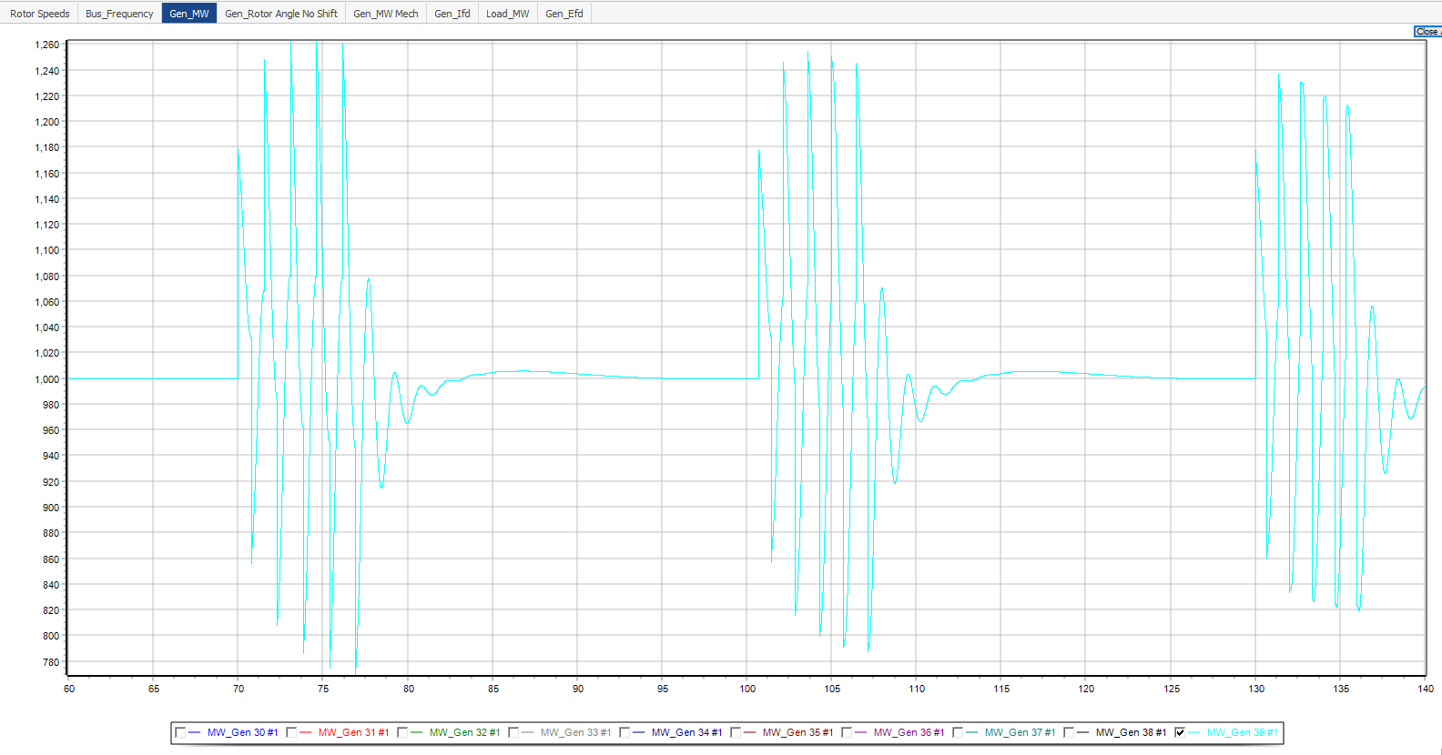
Gen 39 Load Perturbation Frequency Verification
Gen_MW
0.65 Hz
0.7 Hz
0.75 Hz

Slide 37
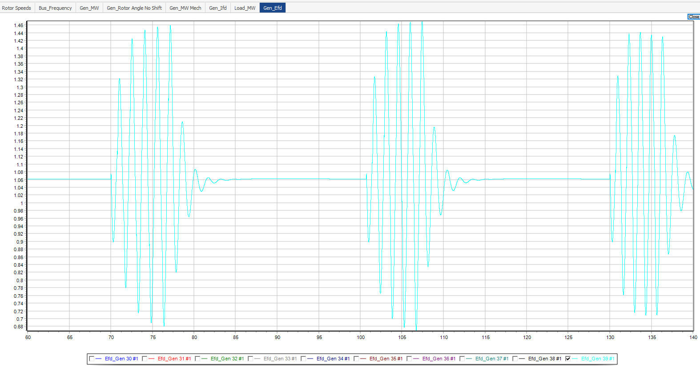
Gen 39 Load Perturbation Frequency Verification
Gen_Efd
0.65 Hz
0.7 Hz
0.75 Hz

Slide 38
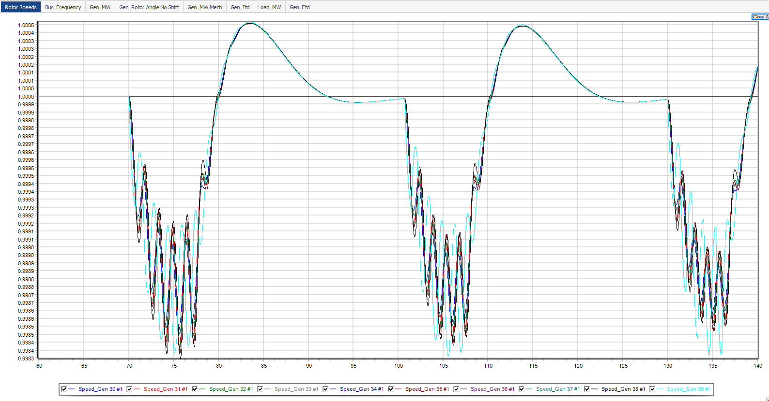
Gen 39 Load Frequency Verification Full Results

Slide 39
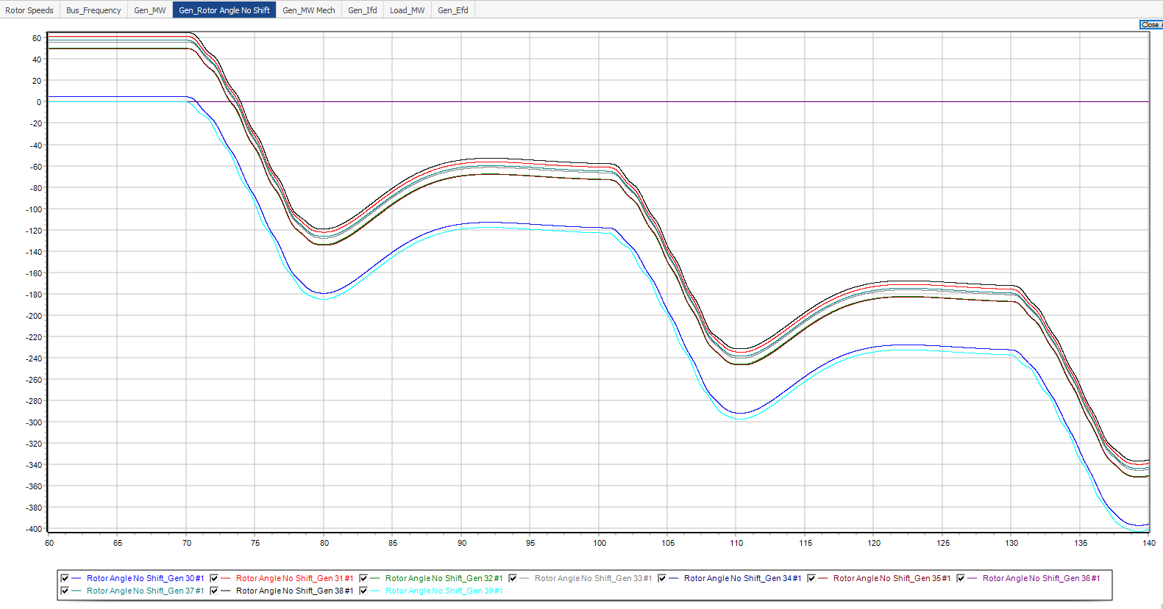
Gen 39 Load Frequency Verification Full Results

Slide 40
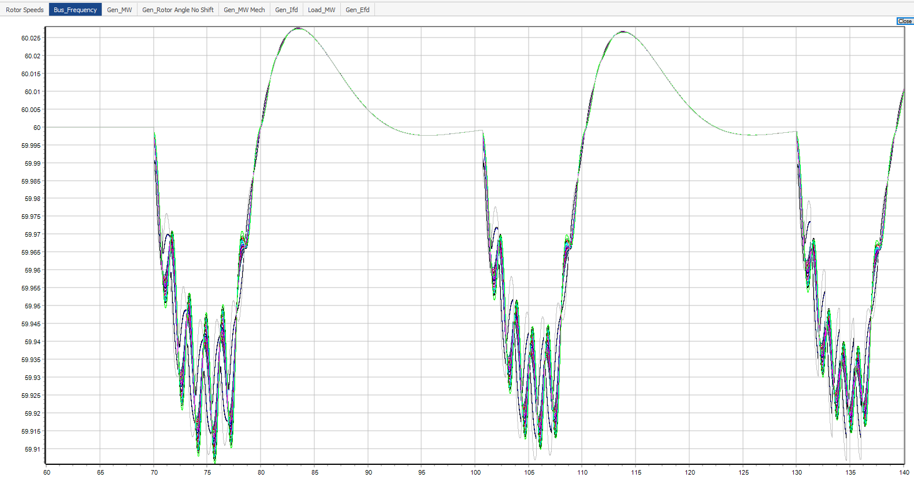
Gen 39 Load Frequency Verification Full Results

Slide 41
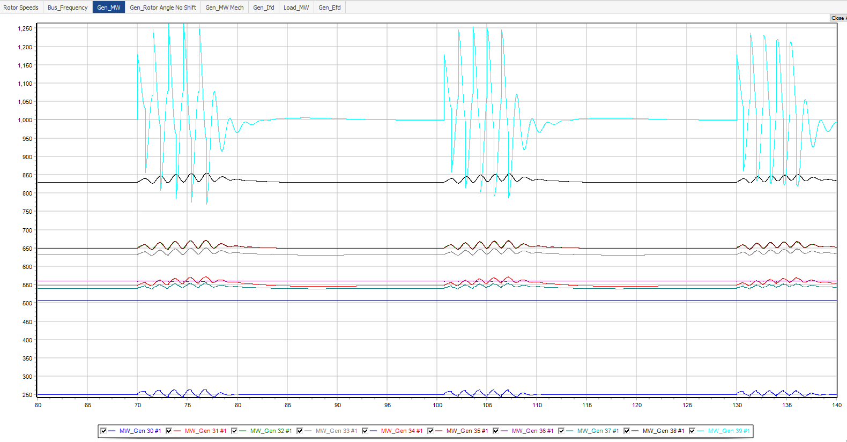
Gen 39 Load Frequency Verification Full Results

Slide 42

Gen 39 Load Frequency Verification Full Results

Slide 43
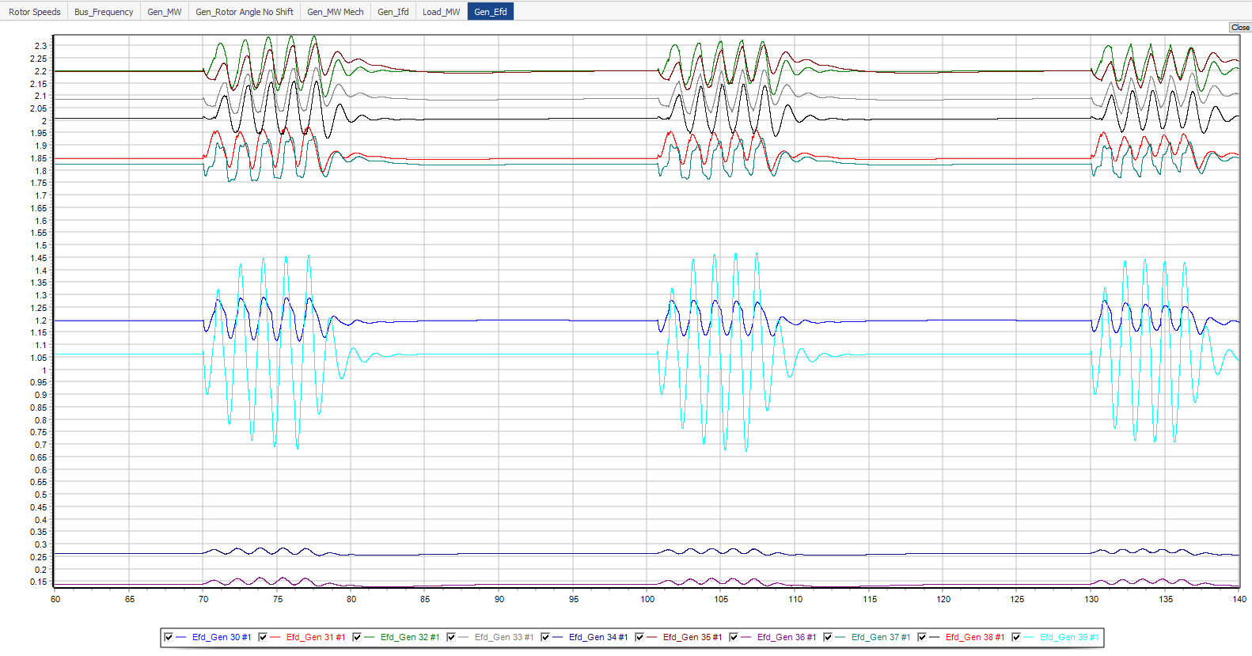
Gen 39 Load Frequency Verification Full Results

Slide 44
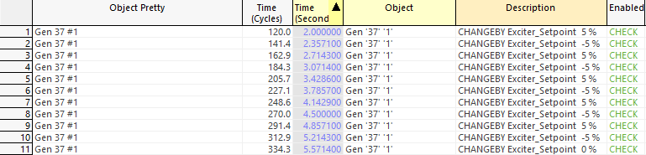
Gen 37 Exciter Setpoint Frequency Sweep
Perturb exciter setpoint by +/- 5% rectangular pulse of starting setpoint
Perturbation frequencies:
1.4 Hz
1.5 Hz
1.6 Hz
1.7 Hz
1.8 Hz
1.9 Hz
Contingency: Gen 37 Efd Frequency Sweep

Slide 45
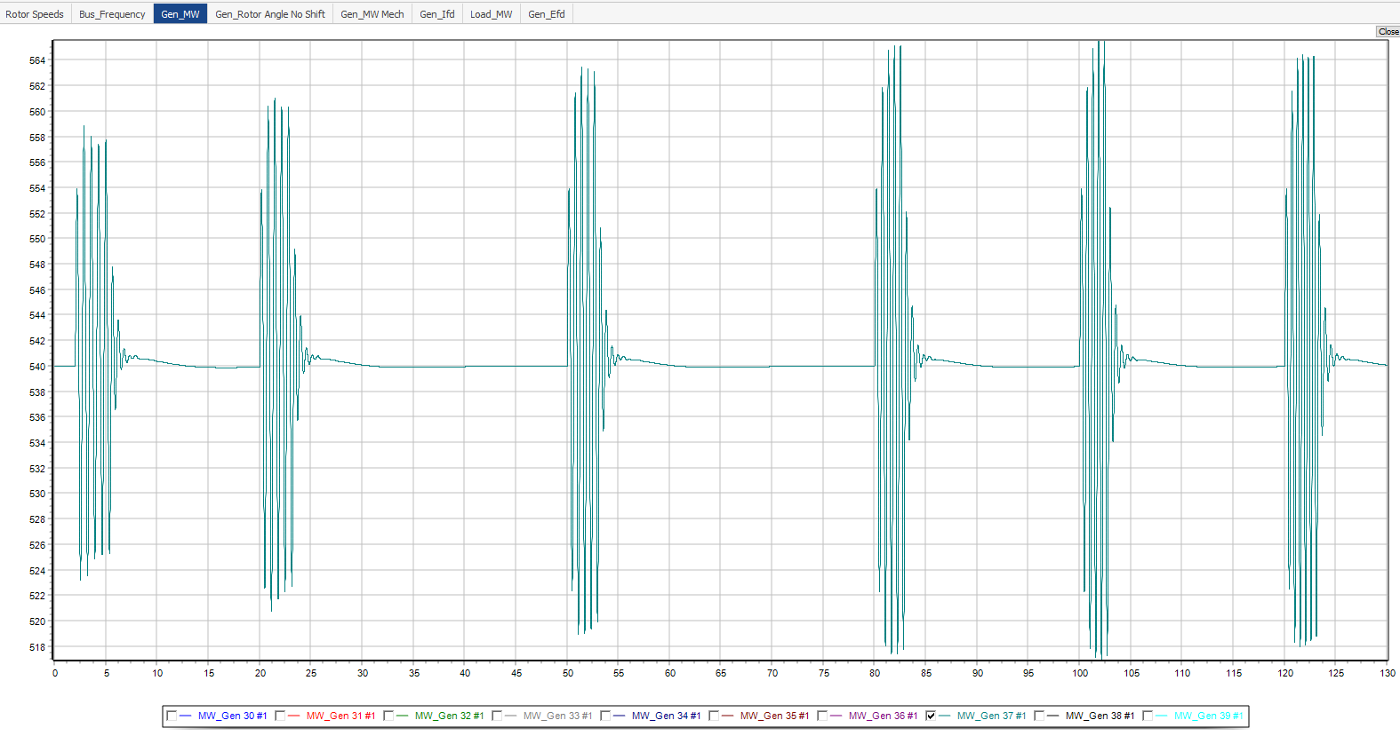
Gen 37 Exciter Setpoint Frequency Sweep
1.4 Hz
1.5 Hz
1.6 Hz
1.7 Hz
1.8 Hz
1.9 Hz

Slide 46
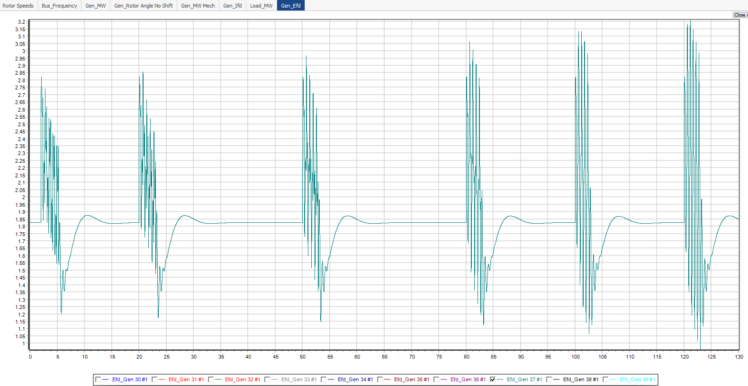
Gen 37 Exciter Setpoint Frequency Sweep
1.4 Hz
1.5 Hz
1.6 Hz
1.7 Hz
1.8 Hz
1.9 Hz

Slide 47
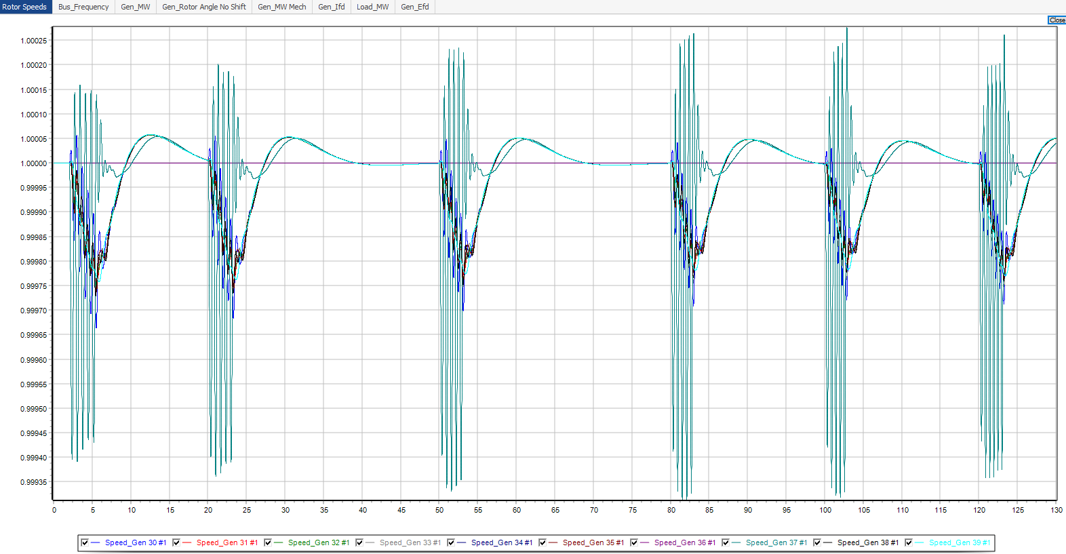
Gen 37 Exciter Frequency Sweep Full Result

Slide 48
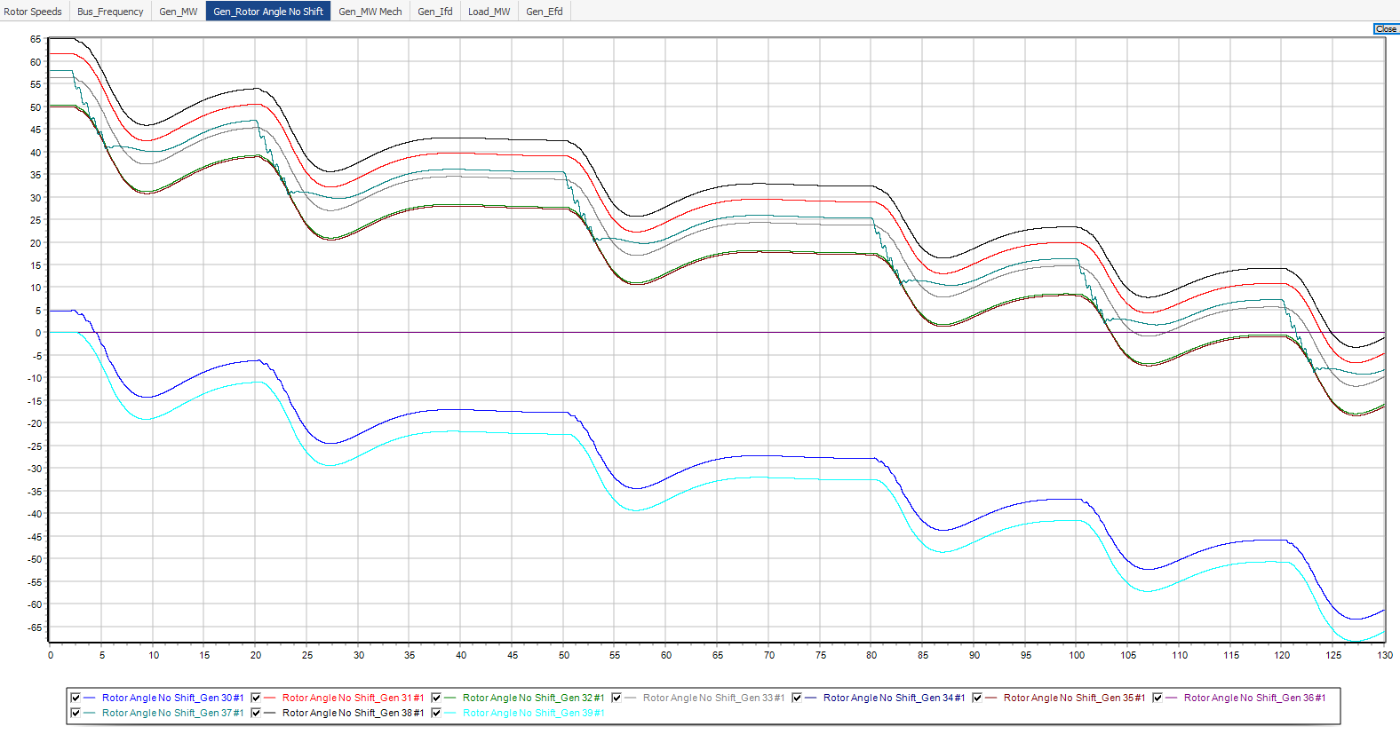
Gen 37 Exciter Frequency Sweep Full Result

Slide 49
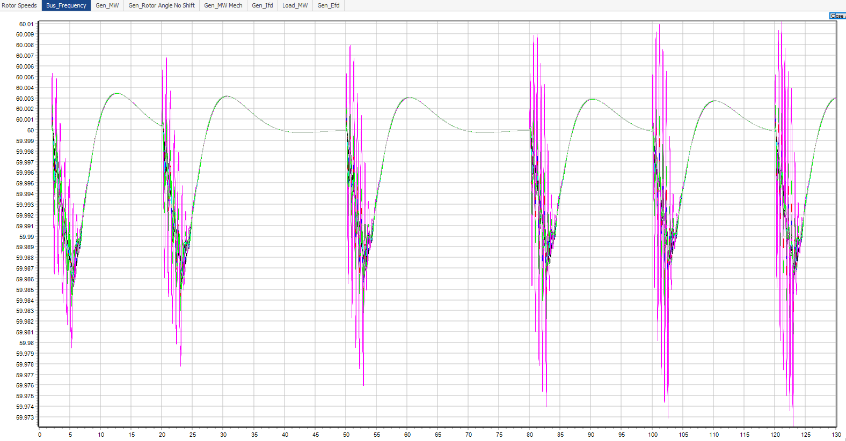
Gen 37 Exciter Frequency Sweep Full Result

Slide 50
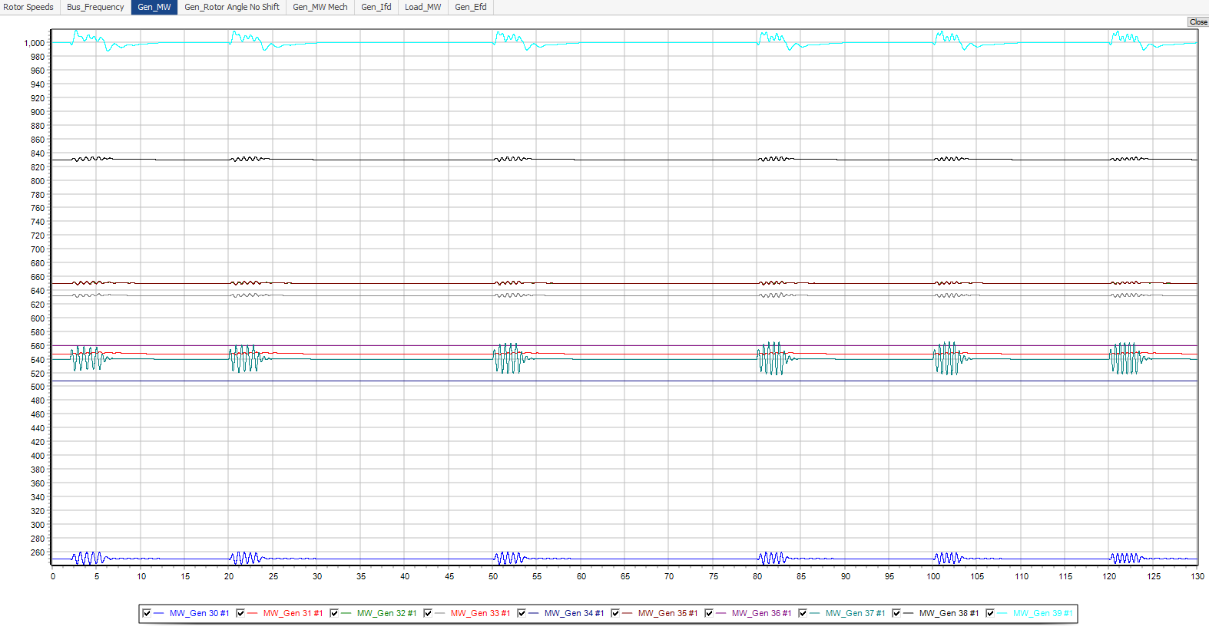
Gen 37 Exciter Frequency Sweep Full Result

Slide 51
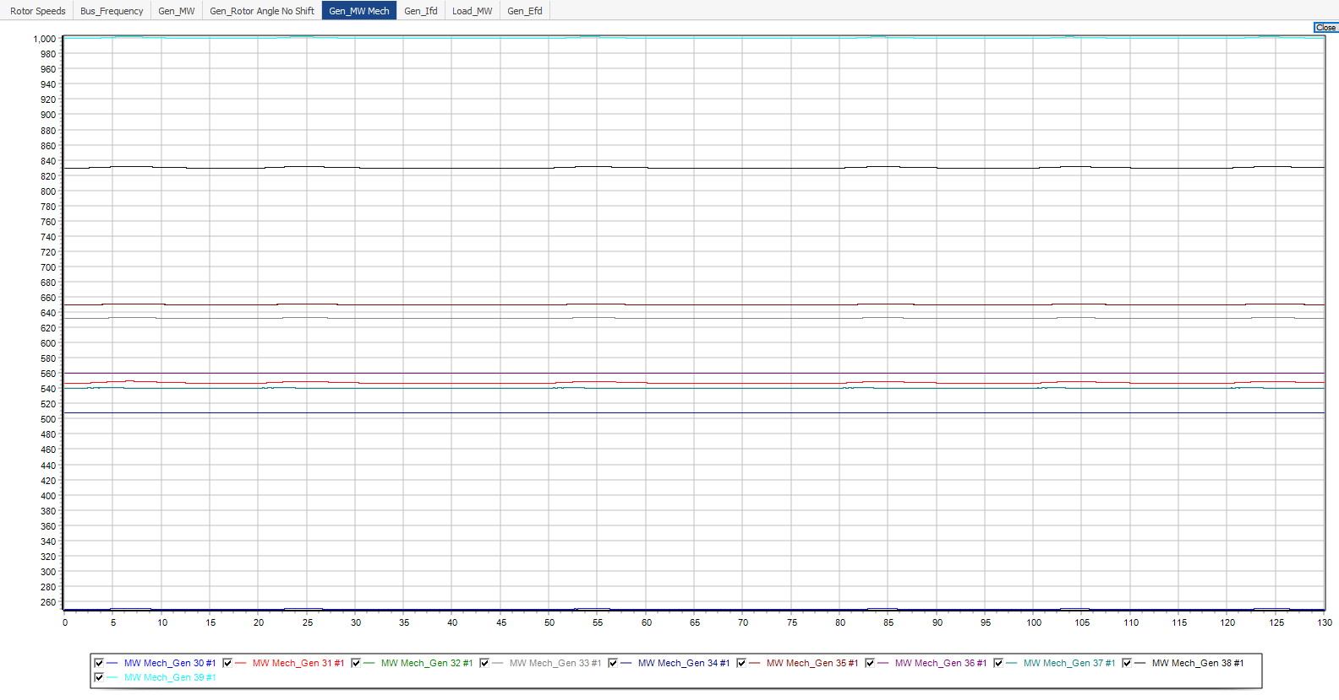
Gen 37 Exciter Frequency Sweep Full Result

Slide 52
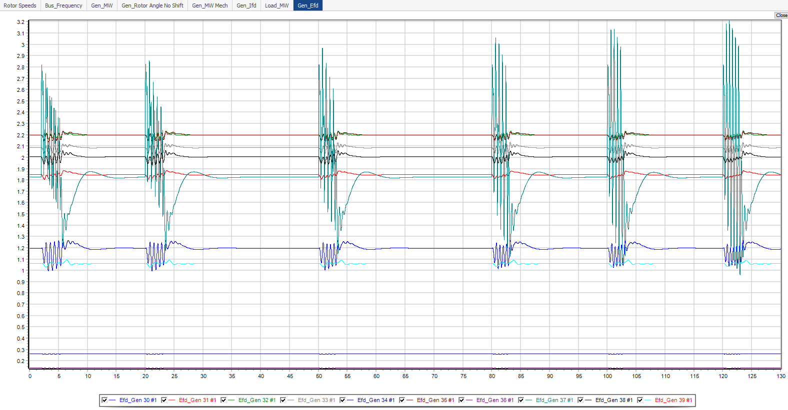
Gen 37 Exciter Frequency Sweep Full Result

Slide 53
Gen 37 Exciter Perturbation Frequency Verification
Scan resulted in a resonance frequency between 1.7 – 1.8 Hz
Perturb system with frequency 1.75 +/- 0.05 Hz
Perturbation frequencies:
1.70 Hz
1.75 Hz
1.80 Hz
Contingency: Gen 37 Efd Frequency Verification

Slide 54
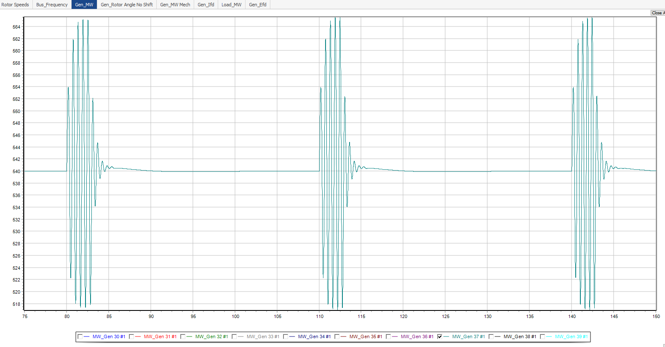
Gen 37 Exciter Perturbation Frequency Verification
1.7 Hz
1.75 Hz
1.8 Hz
Gen_MW

Slide 55
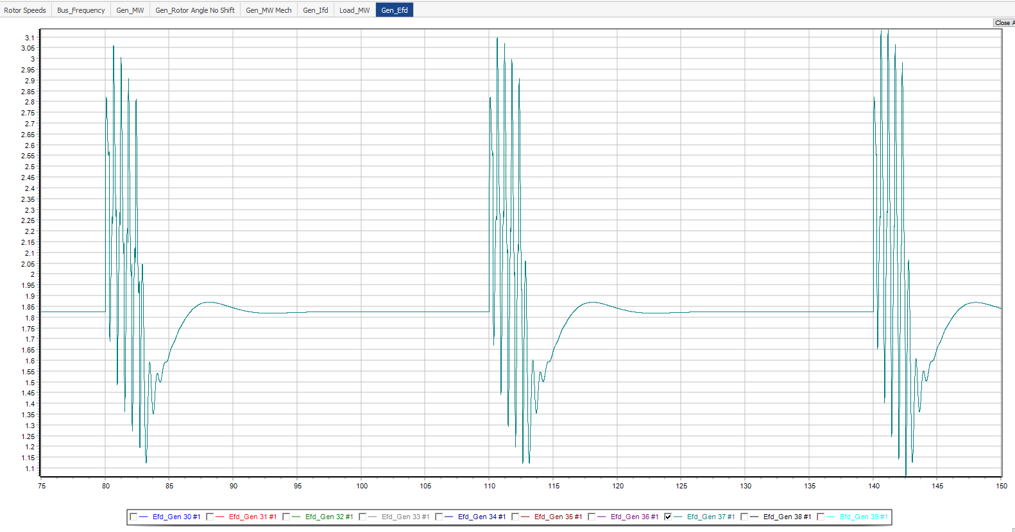
Gen 37 Exciter Perturbation Frequency Verification
1.7 Hz
1.75 Hz
1.8 Hz
Gen_Efd

Slide 56
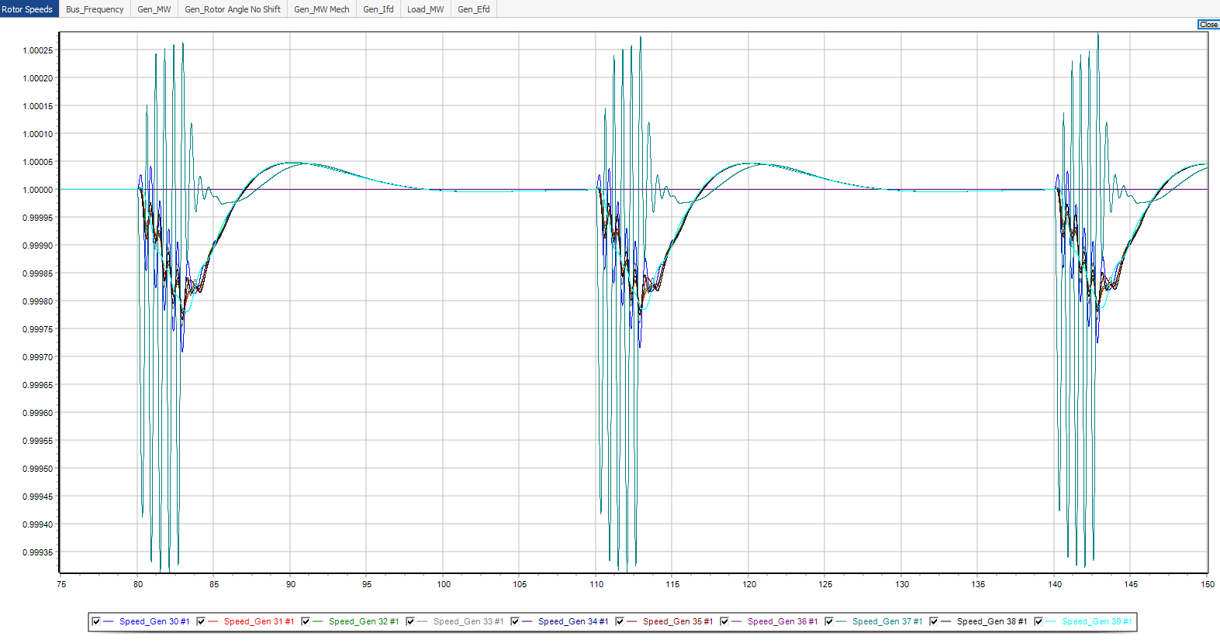
Gen 37 Exciter Frequency Verification Full Result

Slide 57

Gen 37 Exciter Frequency Verification Full Result

Slide 58

Gen 37 Exciter Frequency Verification Full Result

Slide 59

Gen 37 Exciter Frequency Verification Full Result

Slide 60

Gen 37 Exciter Frequency Verification Full Result

Slide 61

Gen 37 Exciter Frequency Verification Full Result

Slide 62

Gen 37 Load Frequency Sweep
Perturb load 25 by +/- 200 MW rectangular pulse
Perturbation frequencies:
1.4 Hz
1.5 Hz
1.6 Hz
1.7 Hz
1.8 Hz
1.9 Hz

Slide 63

Gen 37 Load Frequency Sweep
1.4 Hz
1.5 Hz
1.6 Hz
1.7 Hz
1.8 Hz
1.9 Hz
Gen_MW

Slide 64

Gen 37 Load Frequency Sweep
1.4 Hz
1.5 Hz
1.6 Hz
1.7 Hz
1.8 Hz
1.9 Hz
Gen_Efd

Slide 65

Gen 37 Load Frequency Sweep Full Result

Slide 66

Gen 37 Load Frequency Sweep Full Result

Slide 67

Gen 37 Load Frequency Sweep Full Result

Slide 68

Gen 37 Load Frequency Sweep Full Result

Slide 69

Gen 37 Load Frequency Sweep Full Result

Slide 70

Gen 37 Load Frequency Sweep Full Result

Slide 71

Gen 37 Load Frequency Sweep Full Result

Slide 72
Gen 37 Load Perturbation Frequency Verification
Scan resulted in a resonance frequency between 1.7 – 1.8 Hz
Perturb system with frequency 1.75 +/- 0.05 Hz
Perturbation frequencies:
1.70 Hz
1.75 Hz
1.80 Hz
Contingency: Gen 37 Load Frequency Verification

Slide 73

Gen 37 Load Perturbation Frequency Verification
1.7 Hz
1.75 Hz
1.8 Hz
Gen_MW

Slide 74

Gen 37 Load Perturbation Frequency Verification
1.7 Hz
1.75 Hz
1.8 Hz
Gen_Efd

Slide 75

Gen 37 Load Frequency Verification Full Result

Slide 76

Gen 37 Load Frequency Verification Full Result

Slide 77

Gen 37 Load Frequency Verification Full Result

Slide 78

Gen 37 Load Frequency Verification Full Result

Slide 79

Gen 37 Load Frequency Verification Full Result

Slide 80

Gen 37 Load Frequency Verification Full Result

Slide 81

Gen 37 Load Frequency Verification Full Result

Slide 82

Gen 30 Exciter Setpoint Frequency Sweep
Perturb exciter setpoint by +/- 5% rectangular pulse of starting setpoint
Perturbation frequencies:
1 Hz
1.1 Hz
1.2 Hz
1.3 Hz
1.4 Hz
Contingency: Gen 30 Efd Frequency Sweep

Slide 83

Gen 30 Exciter Setpoint Frequency Sweep
Gen_MW
1.2 Hz
1.3 Hz
1 Hz
1.1 Hz
1.4 Hz

Slide 84

Gen 30 Exciter Setpoint Frequency Sweep
Gen_Efd
1.2 Hz
1.3 Hz
1.4 Hz
1 Hz
1.1 Hz

Slide 85

Gen 30 Exciter Frequency Sweep Full Results

Slide 86

Gen 30 Exciter Frequency Sweep Full Results

Slide 87

Gen 30 Exciter Frequency Sweep Full Results

Slide 88

Gen 30 Exciter Frequency Sweep Full Results

Slide 89

Gen 30 Exciter Frequency Sweep Full Results

Slide 90

Gen 30 Exciter Frequency Sweep Full Results

Slide 91
Gen 30 Exciter Frequency Verification
Scan resulted in a resonance frequency around ~1.2 Hz
Perturb system with frequency 1.2 +/- 0.05 Hz
Perturbation frequencies:
1.15 Hz
1.20 Hz
1.25 Hz
Contingency: Gen 30 Efd Frequency Verification

Slide 92

Gen 30 Exciter Frequency Verification
Gen_MW
1.2 Hz
1.25 Hz
1.15 Hz

Slide 93

Gen 30 Exciter Frequency Verification
Gen_Efd
1.2 Hz
1.25 Hz
1.15 Hz

Slide 94

Gen 30 Exciter Frequency Verification Full Result

Slide 95

Gen 30 Exciter Frequency Verification Full Result

Slide 96

Gen 30 Exciter Frequency Verification Full Result

Slide 97

Gen 30 Exciter Frequency Verification Full Result

Slide 98

Gen 30 Exciter Frequency Verification Full Result

Slide 99

Gen 30 Exciter Frequency Verification Full Result

Slide 100

Gen 30 Load Frequency Sweep
Perturb load 25 by +/- 200 MW rectangular pulse
Perturbation frequencies:
1 Hz
1.1 Hz
1.2 Hz
1.3 Hz
1.4 Hz
Contingency: Gen 30 Load Frequency Sweep

Slide 101

Gen 30 Load Frequency Sweep
Gen_MW
1.1 Hz
1.2 Hz
1.3 Hz
1 Hz
1.4 Hz

Slide 102

Gen 30 Load Frequency Sweep
Gen_Efd
1.2 Hz
1.3 Hz
1 Hz
1.1 Hz
1.4 Hz

Slide 103

Gen 30 Load Frequency Sweep Full Result

Slide 104

Gen 30 Load Frequency Sweep Full Result

Slide 105

Gen 30 Load Frequency Sweep Full Result

Slide 106

Gen 30 Load Frequency Sweep Full Result

Slide 107

Gen 30 Load Frequency Sweep Full Result

Slide 108

Gen 30 Load Frequency Sweep Full Result

Slide 109

Gen 30 Load Frequency Sweep Full Result

Slide 110
Gen 30 Load Frequency Verification
Scan resulted in a resonance frequency around ~1.2 Hz
Perturb system with frequency 1.2 +/- 0.05 Hz
Perturbation frequencies:
1.15 Hz
1.20 Hz
1.25 Hz
Contingency: Gen 30 Load Frequency Verification

Slide 111

Gen 30 Load Frequency Verification
Gen_MW
1.15 Hz
1.2 Hz
1.25 Hz

Slide 112

Gen 30 Load Frequency Verification
Gen_Efd
1.15 Hz
1.2 Hz
1.25 Hz

Slide 113

Gen 30 Load Frequency Verification Full Results

Slide 114

Gen 30 Load Frequency Verification Full Results

Slide 115

Gen 30 Load Frequency Verification Full Results

Slide 116

Gen 30 Load Frequency Verification Full Results

Slide 117

Gen 30 Load Frequency Verification Full Results

Slide 118

Gen 30 Load Frequency Verification Full Results

Slide 119


Appendix A: Power World SMIB Eigenvalues

Slide 120


Appendix A: Power World SMIB Eigenvalues

Slide 121


Appendix A: Power World SMIB Eigenvalues

Slide 122


Appendix A: Power World SMIB Eigenvalues

Slide 123


Appendix A: Power World SMIB Eigenvalues

Slide 124
Appendix B: System Mode (PW and PST)
 | Power World SMIB |  | PST (DC1 Exciter Model) |  | PST (Type 0 Exciter Model) |  | Power World FO Freq Scan
Generator | Damping | Freq Hz | Damping | Freq Hz | Damping | Freq Hz
30 | 0.1015 | 1.1642 | 0.056409442 | 1.153905871 | 0.125313448 | 1.16838607
31 | 0.1676 | 1.2601 | 0.043000306 | 1.038776929 | 0.196388567 | 1.175012527
32 | 0.1844 | 1.3751 | 0.037950439 | 1.237107135 | 0.152493802 | 1.404732142
33 | 0.1443 | 1.6165 | 0.051315888 | 1.399023004 | 0.120573128 | 1.504390767
34 | 0.262 | 1.0722 | No lightly damped freq associated with Gen 34 |  | 0.225951469 | 1.076922038
35 | 0.2139 | 1.3375 | 0.050567433 | 1.13118085 | No lightly damped freq associated with Gen 35
36 | 0.2969 | 1.3198 | 0.056754348 | 1.459699253 | 0.254468125 | 1.511950024
37 | 0.1894 | 1.7445 | 0.058924133 | 1.468813003 | 0.177674914 | 1.765580528 | 1.7 – 1.8
38 | 0.2606 | 1.2586 | 0.040691254 | 0.987041172 | 0.240917221 | 1.21890335
39 | 0.1589 | 0.406 | 0.041773826 | 0.379150343 | 0.135914054 | 0.598678949 | ~ 0.6
 |  |  | 0.086092542 | 0.639953118
Note PW SMIB: Picked freq with smallest damping ratio
Note PST: Gen associated with lowest damped frequency was chosen as the gen with normalized participation factor of 1

